Slide 1


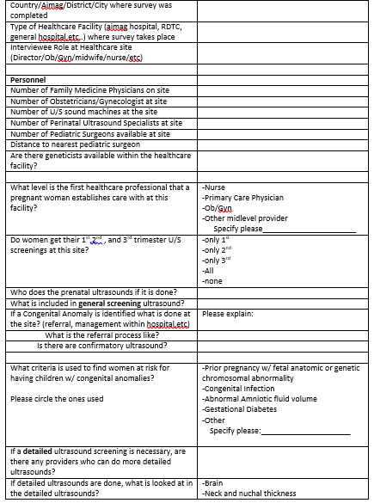
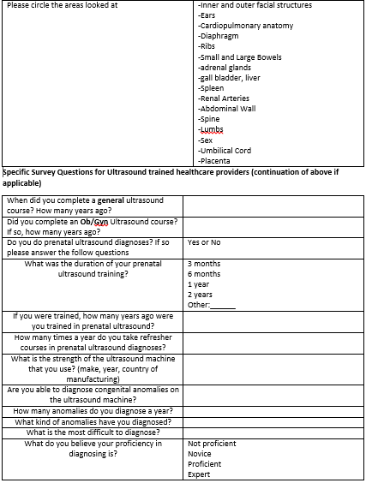
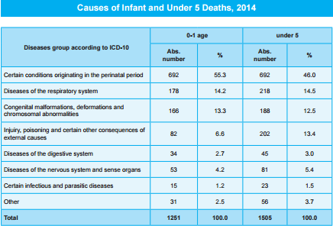
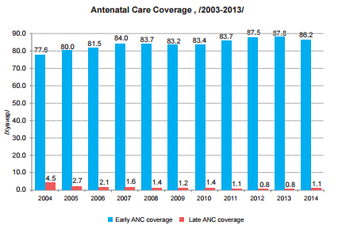
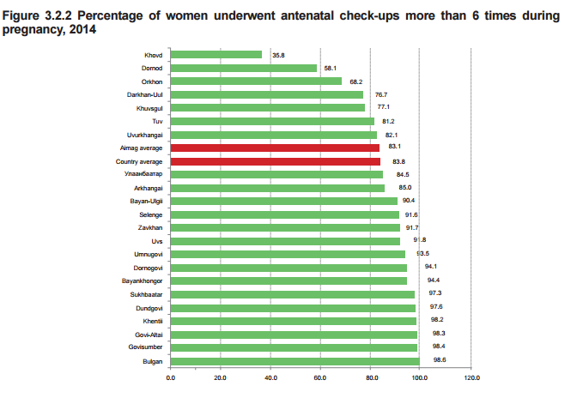
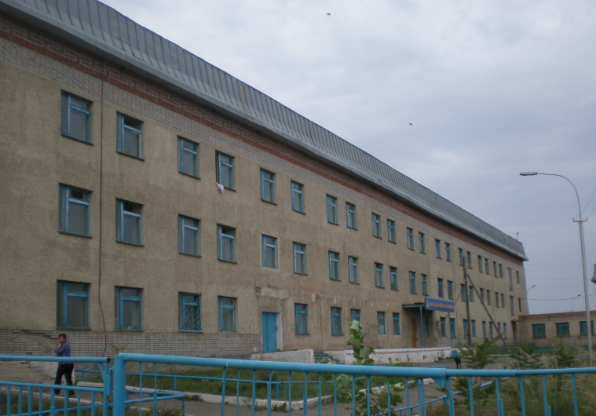
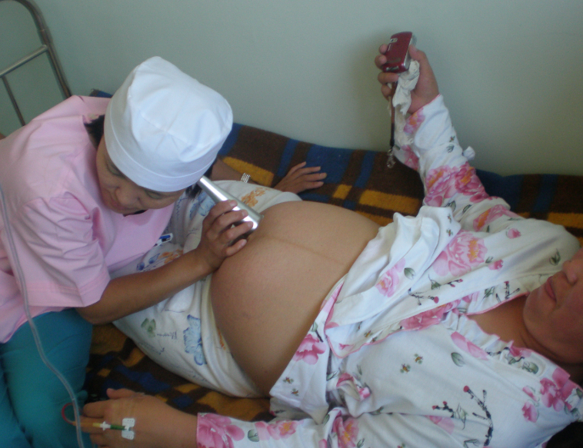
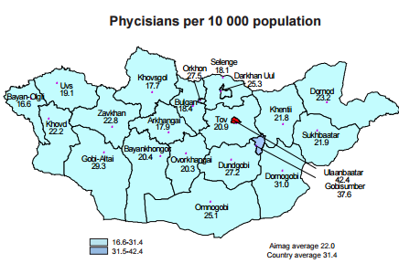
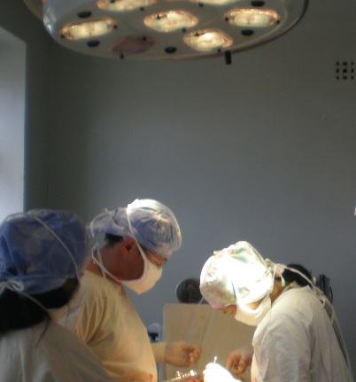
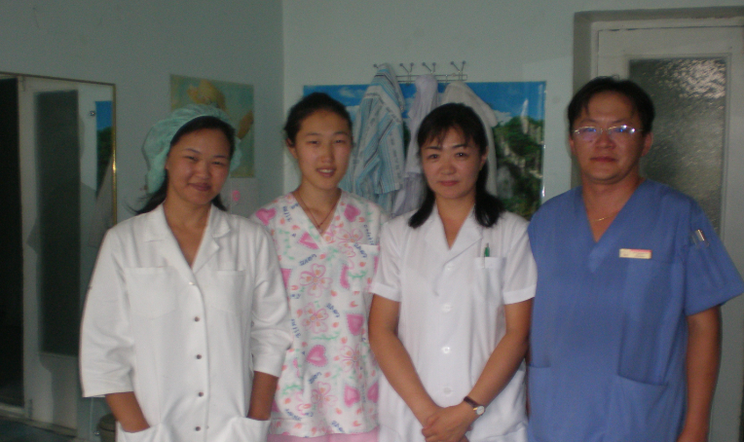
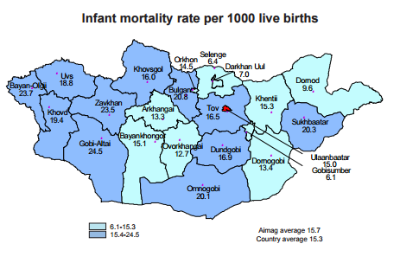
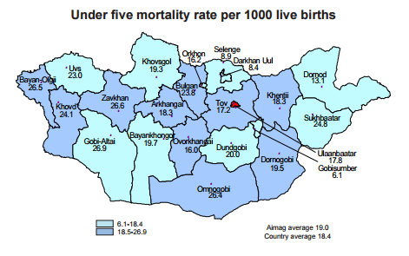
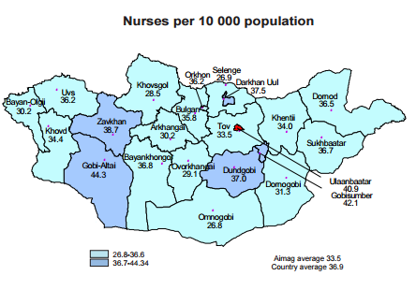



Screening for Congenital Anomalies in Rural and Urban Mongolia
Enkhee Tuvshintogs, BS, Nancy Field, MD, Jargalsaikhan Badarch, MD
American Center for Mongolian Studies, University of California, Davis School of Medicine, & Mongolian National University of Medical Sciences
Introduction
Methods
Discussion
Since the 1990s Mongolia has been working to decrease the rate of infant mortality. It has brought infant mortality rate down from 62.4 deaths/1000 births in 1994 to 22.4 deaths/1000 births in 2015. At this point, Mongolia’s goal is to continue working on it’s Millennium Goals. As of now, congenital anomalies are the 3rd leading cause of infant and under 5 mortality in Mongolia However, it is unclear how congenital anomalies are screened for and referred for preparatory post-natal care.
Specifically, it is unclear how congenital anomalies treatable with surgery are referred to pediatric surgeons in Mongolia. The discrepancies between rural health resources and providers compared to urban settings pose an additional challenge for screening, identifying, and appropriately referring pregnant women in need of specialized care. My study aims to elucidate the human resources, technical skill, and mechanical resources available in rural and urban areas to screen for congenital anomalies. The study focuses on getting a baseline understanding of what resources are already in place by surveying various levels of healthcare providers involved in perinatal care about their knowledge of the resources for identifying congenital anomalies on fetal ultrasound.
On a more detailed level it will also assess if there are ultrasound machines and healthcare providers specifically trained in ultrasounds to screen for congenital anomalies available in the area. With the information gathered from the study, we hope to gain a better understanding of how congenital anomalies are managed in Mongolia, whether or not there are resources available to appropriately identify congenital anomalies, and whether identifying areas of possible improvement can help decrease the rate of infant mortality rate even further.
I will assess the healthcare workers and the system about how screening and referring for congenital anomalies functions via an anonymous Mongolian survey.
The survey is an adaption from the PIPES Surgical Assessment Tool by Dr. Adam Kushner. It will be offered to any provider involved in perinatal care. The providers can be from any level of healthcare. With this information, I hope to gain an understanding of what people working the healthcare already know, as well as gather basic data about the how screening for congenital anomalies is done. The data will then be gathered for basic statistical analysis.
Sites will be all willing hospitals/clinics available in the capital city: Ulaanbaatar. I will also provide the surveys to rural clinics, soum, intersoum, and aimag healthcare centers if possible.
Preliminary literature review and research on health statistics in Mongolia show that there is adequate initial antenatal care for pregnant women with an average of 86.2% of women getting antenatal care coverage in rural and urban areas. The majority of women, save it for three states (aimags), in Mongolia have at least 6 antenatal check-ups. Few had late antenatal coverage. According to the data, in rural areas there are about half the number of total physicians (of all specialties) per 10,000 patients in rural areas compared to the capital. Similar results are also present with nurse availability for number of patients.
The states that have at least a 10% difference from the average antenatal visits of 6 are Khovd, Dornod, and Orkhon. Interestingly, they do not strikingly fewer physicians or nurses than other states, nor are there large differences in infant and <5 year old mortality rate in these states. Thus, on initial review there is some indication that there may be no correlation between access to additional physicians/nurses, infant/under five mortality rate, and antenatal care frequency.
Currently ,however, statistical analysis of congenital anomalies and their distribution in Mongolia are being collected into a database. It would be interesting to compare those numbers to the data here.There is also no clear data available to determine if there are increased incidence and prevalence of children born with congenital anomalies in certain regions.
Background Data Regarding the Mongolian Population, Health and Healthcare Sites
Future Plans
Much of my research has thus far been developing my survey and establishing contacts in Mongolia who are in applicable fields. I have also worked to identify sites where the surveys can be distributed. In March, I will be going to Mongolia to survey health care providers in maternal and fetal hospitals and clinics throughout the capital. Then I will also survey healthcare providers in rural areas in Mongolia, sampling the western states and if time permits some of the eastern states as well.
Objectives
-Elucidate what detection and management mechanisms are in place to screen for congenital anomalies in the antenatal period. Specifically,
-Who provides antenatal care in the urban and rural settings?
-What percent of mothers with prenatal care who have access to
antenatal ultrasound actually get an ultrasound?
-How frequently during a pregnancy does an average woman receive an
ultrasound?
-If a congenital anomaly is identified, what is the referral process to
high risk maternal/fetal medicine and pediatric surgery specialists?
-Are there referral processes?
-Are healthcare professionals in both rural and urban settings able to identify those at risk for congenital anomalies and to detect congenital anomalies when they are present?
-What criteria if any do healthcare professionals use in Mongolia to
identify women who are “high risk?”
-If they are identified as a high risk population, do they get referred to
a specialist?
Acknowledgements
Thank you to Dr. Nancy Field and Dr. Laura Goodman at UC Davis for their advice and guidance, Dr. Jargalsaikhan Badarch at MNUMS for her help and guidance in Mongolia. UCDSOM for allowing me to go to Mongolia to do my project and for the American Center for Mongolian Studies for funding my project and travel to Mongolia.
References
1. Mongolia: WHO Statistical Profile. 2015, World Health Organization and UN Partners
2. Under Five Child Mortality, in World Health Organization 2016.
3. Birth Defects, in Sixty-Third World Health Assembly. 2010, World Health Organization
4. Congenital Anomalies Fact Sheet. 2015 April 2015 6/15/2016]; Available from: http://www.who.int/mediacentre/factsheets/fs370/en/.
5. Health Service Delivery Profile Mongolia. 2012, World Health Organization and Ministry of Health.
6. Health Indicators Mongolia. 2014, Center for Development and Health Mongolia

